Slide 1
Toronto

Slide 2
Automating SFTP Workflows
Daniel Wierdsma
DevOps Engineer @ Tulip
Daniel.wierdsma@tulip.com

Slide 3
Agenda
What is Tulip?
A Little Background
What Did We Build?
How Did We Improve On It?
Demo
Future Plans

Slide 4
What is Tulip?
SaaS Provider
Empowering Sales Associates
Cloud Backend
Notes:
Tulip empowers store associates with mobile apps to look up products, manage customer data, check out shoppers, and message clients. Our Clienteling apps elevate service and drive sales.

Slide 5
A Little Background

Slide 6
What We Had Before
Fairly Basic ETL Pipeline
Pull Files To Worker Servers
Run Importers On Our Files
Notes:
We started this as a pretty basic ETL pipeline, a client drops a file on our SFTP server which was EC2 linux backed. We would then download all of our files at once to a worker server that would then be processes one at a time by our importers. This is a relatively slow process and relied on SSH connections to our SFTP servers as it would sort through which files to pull to the worker server based on time dropped, and would sometimes leave files on our worker servers that could cause partition spacing issues.

Slide 7
Pros
Cons
Simple Process/Design
Fairly easy to understand and build upon
Everything Was In One Place
Everything lived on our worker Linux machines
Small Blast Radius
If something broke it would break only one customers imports
Poor Visibility
Had to go through a lot of logs that were hard to parse through.
Relied On EC2 Instances Too Much
We wanted to move to containerized imports
Cron Based Scheduling
It would be better to trigger our importers automatically

Slide 8
What Did We Build?

Slide 9
Why Did We Change
Moving To AWS Transfer For SFTP
Stop Relying On EC2 Instances
Limit Work Done By Importers
Notes:
We were already moving to Transfer for SFTP as it was announced so we were in the process of moving a client over, so we took advantage of the situation and worked on designing an AWS hosted solution that would help us stop relying on our EC2 instances as much, as we already wanted to move away from these and try to pursue a more containerized tech stack. We also wanted to make it as simple for our importers to know what to run. Before they had to pull all the files at once or do work on the SFTP server itself to determine what to run next, this took time and we didn’t want to have such open permissions on our SFTP servers.

Slide 10
What We Came Up With - Overall
Notes:
Brief description of this, you can see we used SQS queues, some lamdbas, and our S3 backed SFTP service which was easy to create triggers on. Cloudcraft is what we used to create these diagrams

Slide 11
What We Came Up With - Ingest
Notes:
Here was the ingest side of our first iteration of this new framework, as you can see on the left hand side of this diagram is when a file is dropped on our S3 bucket, from AWS Transfer for SFTP we trigger a lambda on it immediately. This lambda determines whether the file is one that we support and then puts it in the associated queue. Something to keep in mind here is that this is all done manually, created the lambda functions, the queues, and must be done on a per customer basis. So each new customer that we would want to support this on would need to be manually created. Keep in mind that we needed to create a queue for every file type before we were able to run this to prevent any errors of a queue not existing and potentially stopping any files being run.

Slide 12
What We Came Up With – State Updater
Notes:
From here the importers would consume from the ingest queues for the given file type it is trying to run. It would then process the files the same as it usually would but before it returns it would send a message to one of two queues. The success queue is obviously for when the file succeeds it would then hit a success lambda that would move the file in S3 from our upload directory to a completed directory to mark that they are done. And a similar process for if the importer fails in any way by moving the file to the failed directory. Keep in mind though this has no fallback in case the importers silently fails, so the file would stay in upload forever and we wouldn’t know the state of it at all.

Slide 13
Takeaways
Importers Are Only Responsible For Importing
Added Config Files
Lots Of Overhead
Still Didn’t Have Great Visibility
Good First Step; Could Be Better
Notes:
Some Takeaways from this framework, it was a good basic design that did initially what we wanted, it reduced the work done by importers, it doesn’t populate the server with thousands of files that could fill up our EBS volumes super quick. This is also practically no change to our clients either as from their perspective they drop a file then there is a black box like thing that makes it appear on their iPad after we import the data. We also added some configuration in terms of how the imports run in terms of expected file name, file type, which importer runs what that is much easier to change than diving in to the code and knowing exactly where each reference is.
There were some issues with this though. We needed to create each queue and lambda manually, which took about an hours work. Which is just too long and not sustainable as we moved more clients over. This also has a lot of overhead that wasn’t necessary, we would create about 12 ingest queues and some would never get used, which we could have turned in to a cloudformation stack but that was deemed a waste of resources, and having a very similar process for both Successful and Failed files that was very inefficient. So we regrouped with the stakeholders to try to come up with a better solution. This was a good first step but could definitely be improved upon, so we did…

Slide 14
How Did We Improve On It?

Slide 15
What We Improved
We made the lambdas multi-tenant
Only one set of lambdas we don’t need to create a separate framework for each new client.
Serverless Framework To Manage Lambdas
We now use serverless to deploy and track the state of our lambdas.
Better Visibility
We created better logging, and Cloudwatch metrics.
Added DynamoDB Tables
We added better data of the current state of files, constantly updating the associating records with their current state.
Notes:
A big thing to mention here that this framework is used for all of our clients, and any new clients that we create automatically get an AWS Transfer for SFTP user so it is ready for a customer to drops files in almost immediately and queues will start to be created. We started to deploy this framework through serverless which mitigated create a troposphere cloudformation stack that we would manually create instead of the quick configuration of a serverless yml file. Adding cloudwatch metrics helped track the overall progress of our importers on a per tenant and file type level. And we added DynamoDB for better tracing of specific files and what happened to them and what state they are currently in.

Slide 16
What We Have – Overall
Notes:
Do a deep dive in to how each portion of these works, also go in to how serverless framework works. This architecture is obviously a little more complicated than the previous version, but at it’s core it’s pretty much the same as the past version with some extra safety nets. We will go in to each of the resources seen here in detail and talk about the improvements that were made to each one and what they are doing. A big thing to mention here that this framework is used for all of our clients, and any new clients that we create automatically get an AWS Transfer for SFTP user so it is ready for a customer to drops files in almost immediately and queues and Dynamo record will start to be created.

Slide 17
What We Have – Ingest
Notes:
This part of the framework as you may remember is remarkably the same, except there are some hidden cases that don’t really show up on an architecture diagram. We now don’t create all 12 queues manually, we get the lambda to create them if they don’t already exist when you need to send a message to that queue. This forces the lambda to only create queues that need to be used and we don’t want a bunch of extra queues sitting around doing nothing except racking up costs. We also now send state of a given file to a Dynamo DB table that maintains records for each individual file for each tenant each uniquely identifier by a generated UUID in the lambda. A timeout field is also assigned that is by default 7 days after the file drops, this timeout makes sure that our importers are running in a timely manner. We also move the file to a new directory within S3 as soon as our lambda processes it to maintain state of the file in multiple locations just in case any given one fails.
Along with this state being tracked through Dynamo and S3 we also send metrics to CloudWatch throughout this entire framework to have some stats on how the health of our importers are. We later turn these metrics in to dashboards to track the day by day progress of files from a high level letting you know who many have been received, how many have started, how many timed out, etc. We can also create alarms based on this data to email someone and let them know if there are unusually high error rates. We also have a content check on each file that is dropped by using the S3 Etag metadata to ensure that we don’t have the same file being queued to run multiple times in case the client is accidentally stuck in a loop

Slide 18
What We Have – State Updater
Notes:
Our state updater is very similar to the one we had in our first attempt, except we merged the lambdas for both failure and success as they did pretty much the exact same task. As the importer is running it sends state checks to an SQS queue specifying whether it is in progress, completed or failed. This in turn triggers a Status Updater lambda that sends the state update by moving the file in the S3 bucket, changing the record in Dynamo with the new state and giving it a new timeout as we don’t want our importers running for more than 24 hours, and provides metrics to Cloudwatch that we can once again use for observability on the health of our importers. We also do an integrity check similar to how we did in the ingester by checking our Etags to make sure that we are not updating the wrong file and ensure that we are still in a good state.

Slide 19
What We Have – Deadletter
Notes:
I mentioned earlier that the core of this new version was the same with some extra safety nets, I’ll get in to a little bit more by what we mean by this right now. We have two extra pieces that required some extra resources so that we can ensure everything is running smoothly, this is our deadletter checker, and our timeout checker.
For our deadletter section, this should be familiar to you if you’ve worked with queues before, we have a deadletter assigned to each of our queues. This is in case there are any issues with the sending messages to the queues and receiving messages from it. This could be a limited number of sends received for the same message, limited number of receives on the same message to make sure the lambdas aren’t stuck in an infinite loop, and any possible hardware issues with the queues themselves.
This lambda consumes from our deadletter and then moves the file to the failed directory within S3 as there was something wrong and it may not have been processed fully or at all. It also provides metrics to cloudwatch, and updates the state in Dynamo as well.

Slide 20
What We Have – Timeout Checker
Notes:
Another check that we added for this framework is a timeout checker that checks Dynamo records to see if any of the files have timed out; You may remember earlier that a file times out after 7 days after placement and 1 day after it starts to run. This then marks the file as timed out in both S3, Dynamo, and Cloudwatch metrics which we will now get a little more in to.

Slide 21
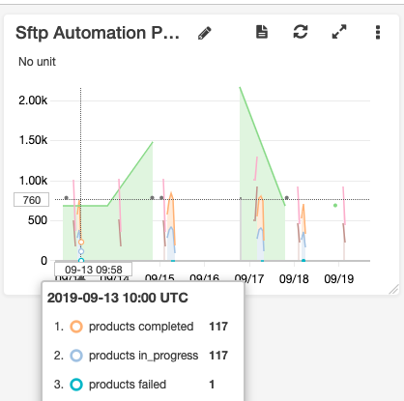
CloudWatch Metrics
Metrics For Each State And Tenant
Helps out parse on a per customer basis the progress of our imports.
Created Dashboards Per Tenant
We created dashboards for each of our live customers that show the metrics that we have created on a handy graph.
Data Can Be Used To Create Alarms
These metrics allows us to set up alarms that can let us know before our clients that something is wrong with imports.
Notes:
Here we can see a little more details on our cloudwatch metrics and how we are utilizing it. We create metrics in our lambdas for each state a file reaches, and assigns a tenant to the given metric so that we can see the stats on a per customer/tenant basis. From this tenant data we are able to make dashboards like the one on the right on the screen, you can see it shows product files that are in_progress have been completed and how many failed. There are more data points such as dead lettered or timed out but this captures it well. However as you can see from this image cloudwatch does have some issue displaying data as the metrics don’t get defaulted to zero, but that is something that you can live with
We can also use these metrics to create alarms, such as if more than 5 files failed over the past hour then something might be wrong, or you could split it on a percentage base that can easily tell you the health of the importers and let you know when something might be broken when in previous versions we would have no idea if an importer failed unless something didn’t show up in app that was noticed by us or the client.

Slide 22
Dynamo DB Records
Provide State For Specific Files
In our Demo we have a shot where we show the date a file was dropped, current state and other details.
On-Demand Read/Write Provisioning
This allows us to not worry about throttling our lambdas that could have many running at once.
Supports Timeouts
This is good for determining whether our importers got in to a bad state or if they are running at all.
Notes:
Our Dynamo DB is another state store that keeps us updated on a per file basis and what state it is currently in. From here we can filter down which files failed, what reason they failed, and where they currently live on SFTP so that we can try to run them again. We are able to set this up with On-Demand Read/Write Provisioning so that we aren’t getting throttled when we have many different lambdas trying to hit this table at a time, we actually ran in to this when we were limiting 5 read/write units which was not nearly enough.
With this table we are also able to track timeouts which we have previously discussed in our architecture diagrams.

Slide 23
Serverless Framework
service: sftp-automation
provider: name: aws runtime: python3.7 region: us-east-1
functions: ingester: handler: src/ingester/lambda_function.lambda_handler role: SftpAutomationRole events: - s3: bucket: ${self:custom.s3Bucket}
resources: Resources: SftpAutomationRole: <IAM Permissions Go Here>
Notes:
Here is just a little snippet of how our serverless framework is setup. As you can see at the top we specify the service name, then our provider to give the framework a little information of where this is all going and how it should be set up.
Then we specify our functions, in this case I’m showing the ingester lambda. You can see here I specify which function is the actual handler for the lambda (there are other helper files as well) and the IAM Role we want to provide it. We also add the S3 trigger that starts the lambda Last we specify the IAM resource itself giving basic roles such as cloudwatch logging, and other simple tasks the lambda needs to do

Slide 24
Pros
Cons
Much Better Logging
Easy to find logs and metrics
Allows Us To Containerize
We can now containerize and standardize our imports easier
Less Overhead
If something broke it would break only one customers imports
More Services
Had to go through a lot of logs that were hard to parse through.
Large Blast Radius
Since we have a multi-tenant service any outage affects all customers
Still Cron Based Scheduling
It would be better to trigger our importers automatically

Slide 25
Demo
Notes:
Would go in to our command line and show us placing files in SFTP and then watching the progress through lambdas and DynamoDB, should be a couple minutes, will have the tabs and everything opened beforehand. Not sure if I should pre-record a video and post that in the deck instead

Slide 26
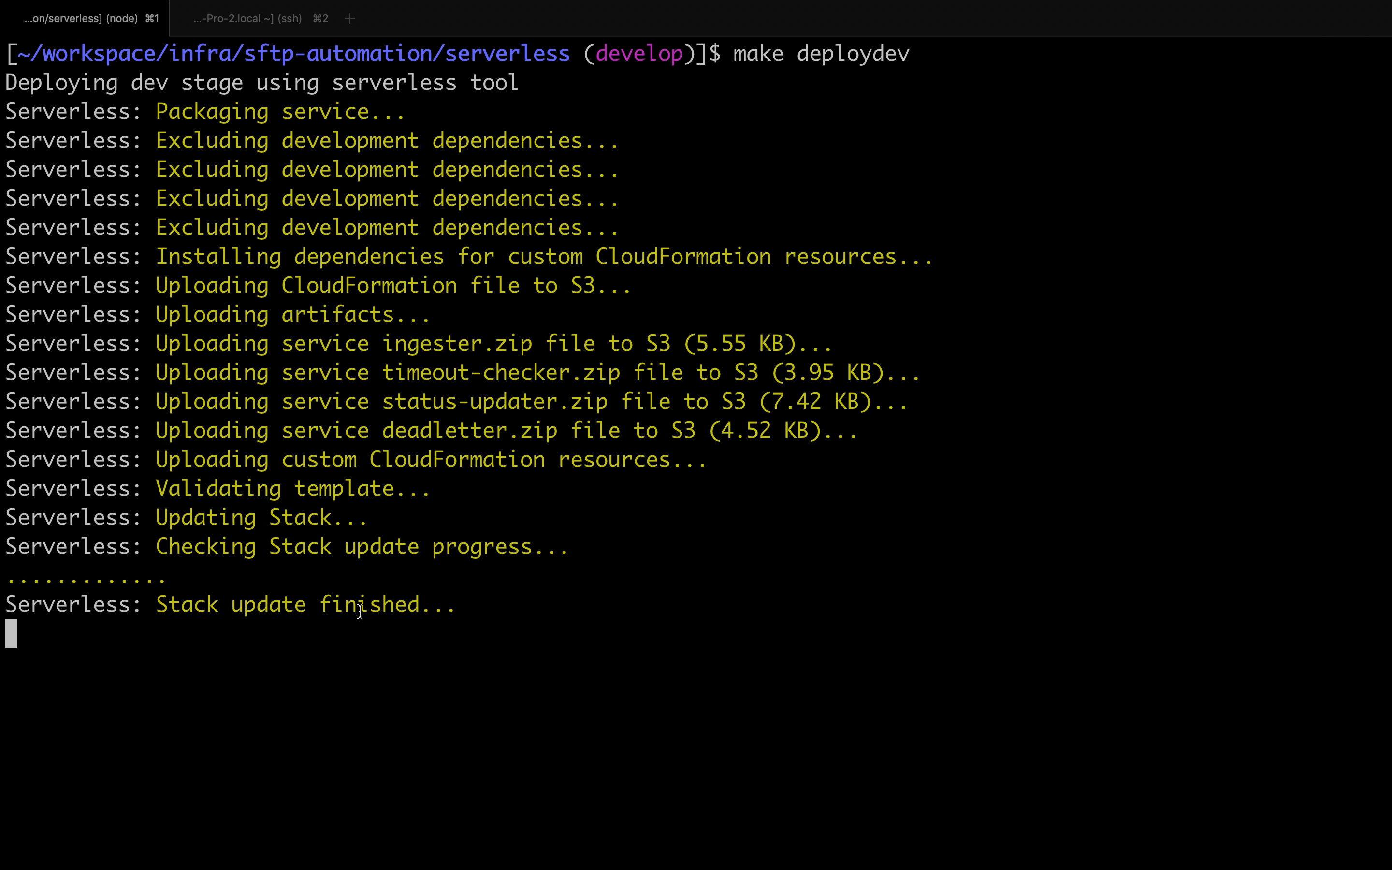
Demo

Slide 27
Future Plans

Slide 28
How To Make It Even Better
Change How Importers Run Files
We want to make each message sent to importers a record instead of a file location
Rework The Imports Themselves
Create a configurable ETL process to enforce data standards
Change How Our Importers Are Hosted
Either containerized, or Serverless frameworks
Notes:
As always we should always be looking to improve on our processes, in this case there is one point of focus for us at Tulip. And that is improving the imports themselves. We are still in planning stages of how we want to do this, but the main point right now is how we are communicating what we want to process to our importers. We are thinking of making each message in our queues to be records in the files we want to process instead of just where the files lives currently. This can either be done through containerization, serverless lambda similar to the rest of the automation framework.

Slide 29
Daniel Wierdsma
Daniel.Wierdsma@tulip.com

